Slide 1



Seasonal and longitudinal nutrient limitation patterns in a watershed influenced by irrigation delivery and return flow
C Arango, S Roley, A Alexiades

Slide 2
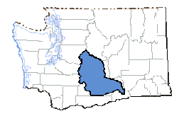
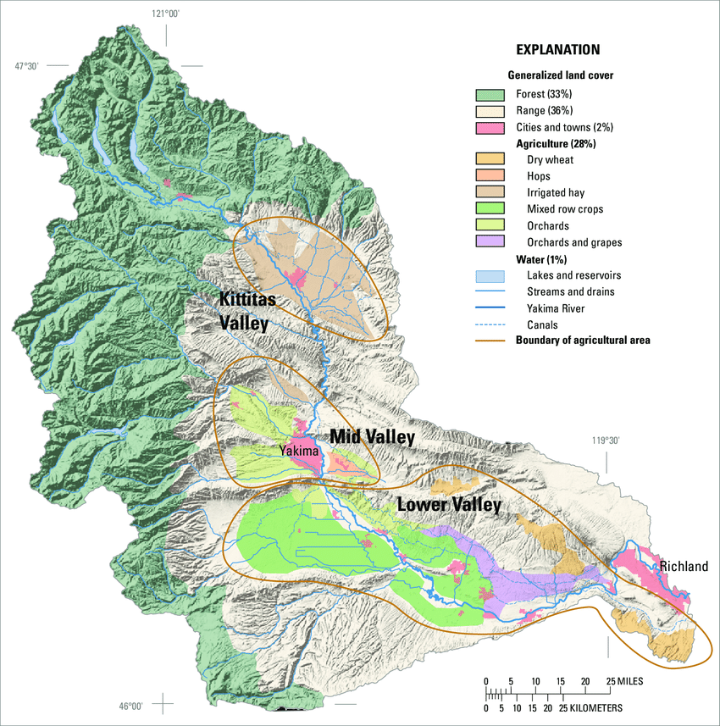
The Yakima Basin
Largest basin entirely within Washington
Mixed land use roughly evenly split between
Forest
Range
Agriculture
Johnson 2007

Slide 3
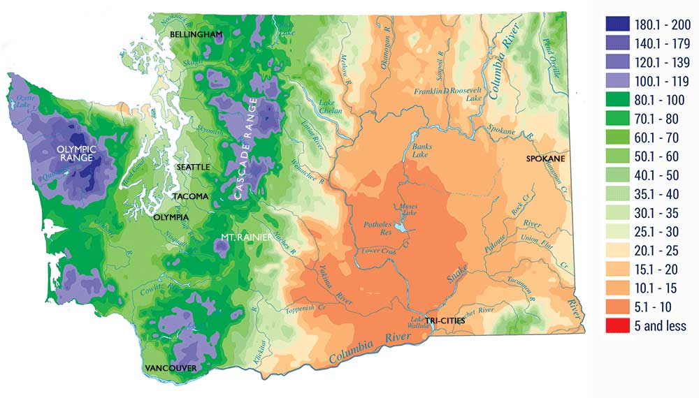
Strong Precipitation Gradient
WA Dept. of Commerce
Forested headwaters up to 200” precipitation
Alluvial valleys less than 10” precipitation

Slide 4
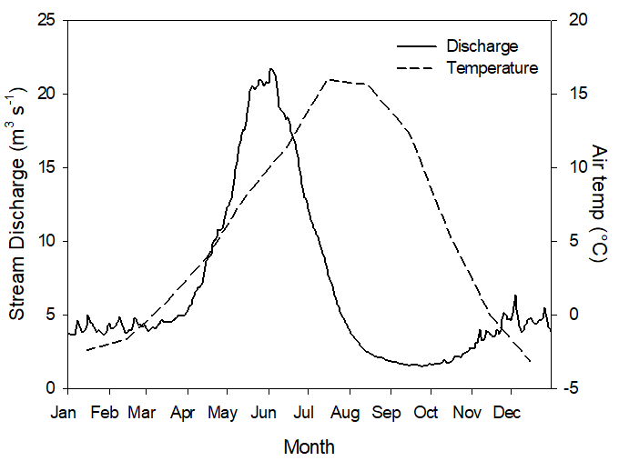
Highly Seasonal Precipitation
80% of
precip
Most precipitation as winter snow
Snowmelt runoff pattern

Slide 5
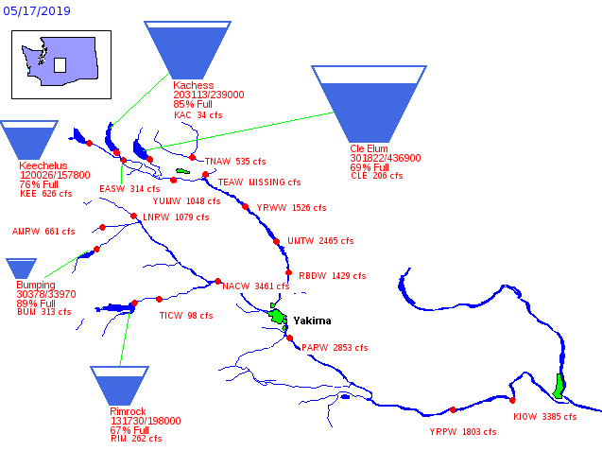
Water Infrastructure
1 mil acre feet
storage
USBR
Headwater storage reservoirs capture snowmelt for summer delivery to irrigation districts

Slide 6
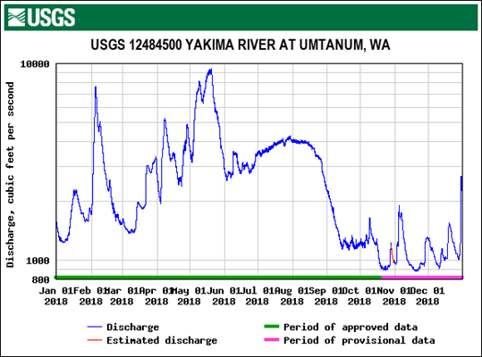
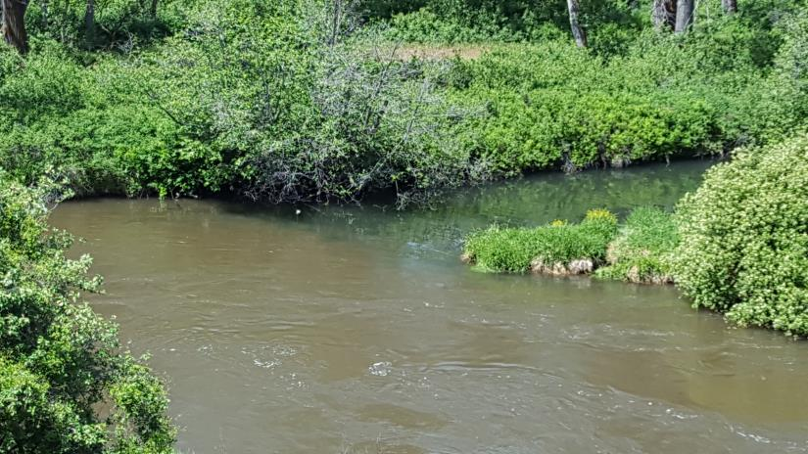
Irrigation Delivery and Return Flow
Low nutrient snowmelt delivered throughout summer
Yakima side channel
Return flow has lower water quality
Irrigation return flow

Slide 7
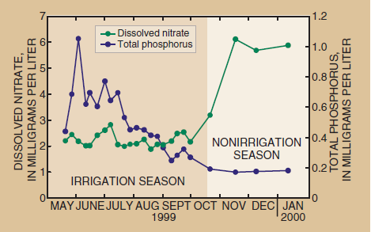
Irrigation Alters Seasonality of N:P Ratio
Fuhrer et al. 2004
Low NO₃⁻ snowmelt delivered to fields + sediment erosion = low N:P
NO₃⁻ -rich groundwater discharged after irrigation = high N:P
This pattern was documented in one tributary drain

Slide 8
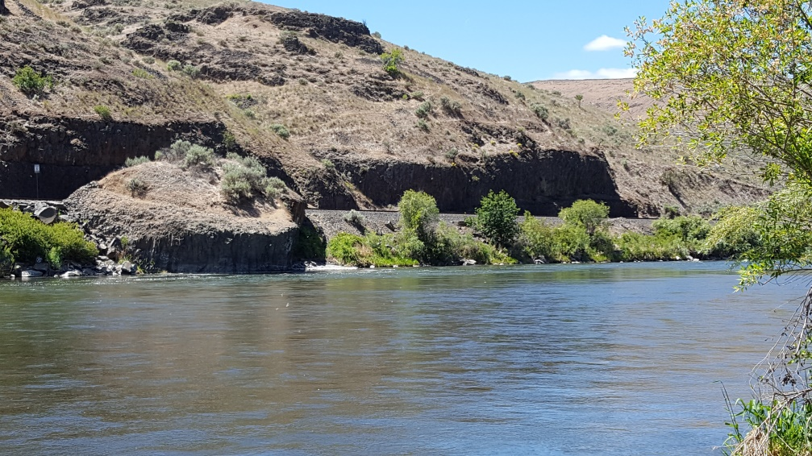
Does irrigation delivery affect the nutrient limitation status of stream biofilms?
We hypothesized:
1 – seasonal differences in stream water nutrient concentrations
2 – seasonal differences in nutrient limitation status for autotrophs and heterotrophs
3 – spatial differences in nutrient concentrations due to irrigation return flow dominating downstream sites…
4 – …leading to increased role of Si in GPP in downstream sites

Slide 9
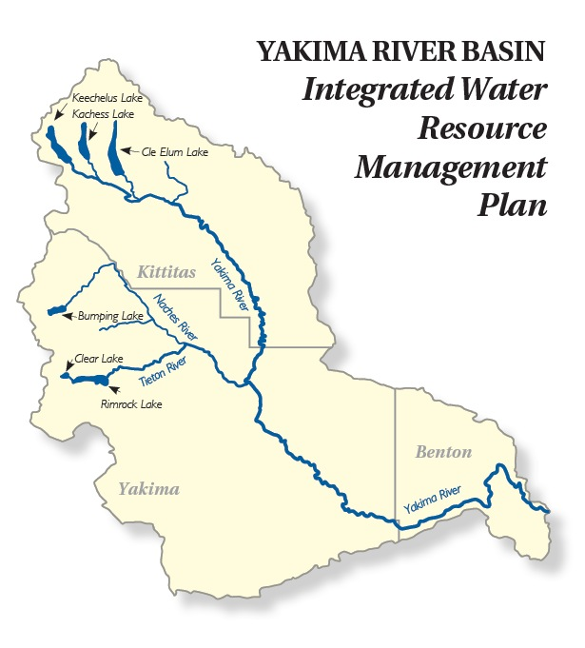
Study Sites
Arrayed longitudinally approximately equidistant along the river continuum
Upper basin generally has better water quality than lower basin

Slide 10
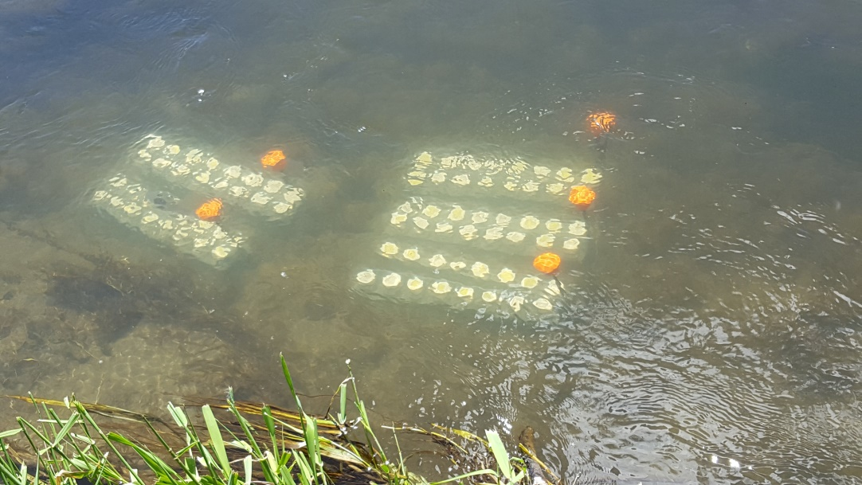
Study Design
NDS deployed in 6 main stem sites
Fully crossed treatments of N (as NO₃⁻), P, and Si (n=80 per deployment)
Deployments in summer during irrigation delivery and in fall 2-4 weeks after irrigation
12-14 day deployment; light+dark assays in lab to measure production and respiration

Slide 11
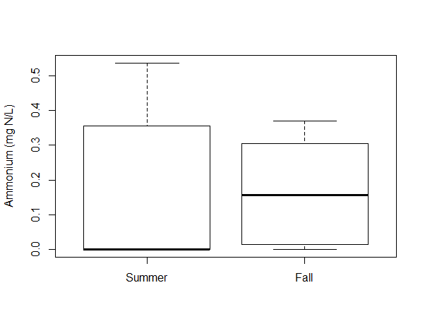
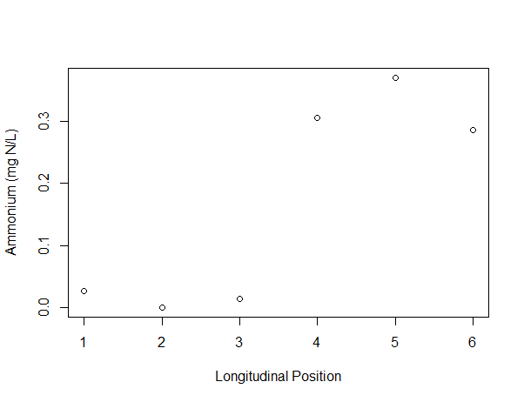
Results: Nutrient Concentrations
Lower basin
Upper basin
paired t-test, p=0.79
Ammonium did not vary seasonally
Below detection in 4/6 sites in summer
Lower basin had higher ammonium than the upper basin in the fall

Slide 12
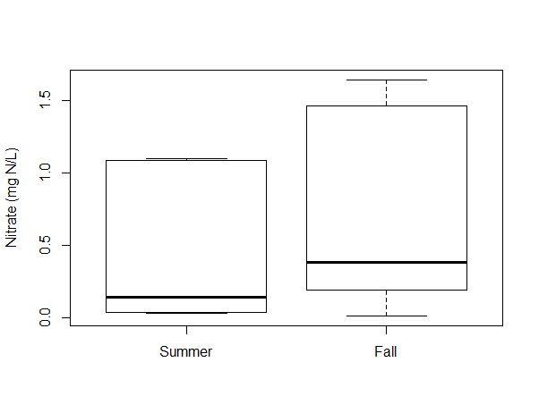
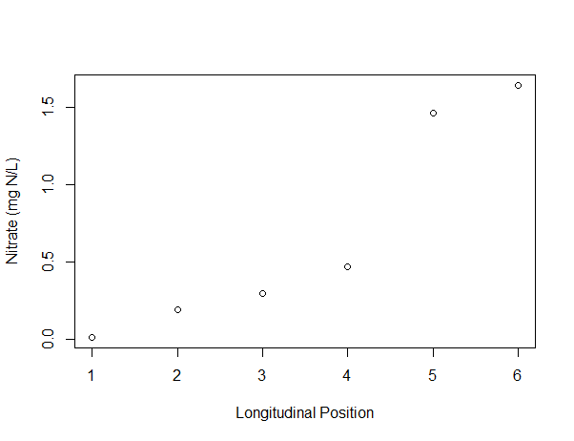
Nutrient Concentrations
Lower basin
Upper basin
paired t-test, p=0.026
Nitrate was higher in fall compared to summer
Nitrate loads increased moving downstream in summer and fall (fall shown)

Slide 13
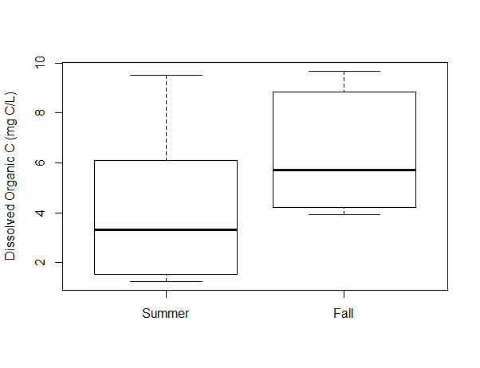
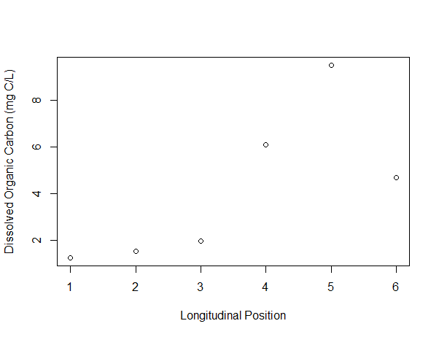
Nutrient Concentrations
Upper basin
Lower basin
paired t-test, p=0.19
DOC ranged from 1.2 – 9.7 mg C/L, but no seasonal difference
DOC higher in the lower basin in summer but not fall

Slide 14
Nutrient Limitation Status of GPP
Summer
→Fall
N
→ no lim
no lim
→ no lim
Nutrient limitation status changed in 3 sites between summer and fall
Release of N limitation in two sites
Silica became important at the downstream sites that generally have higher nutrient concentrations
no lim
→ no lim
N+P+Si
→ Si*
P
→ Si
?
→ Si*

Slide 15
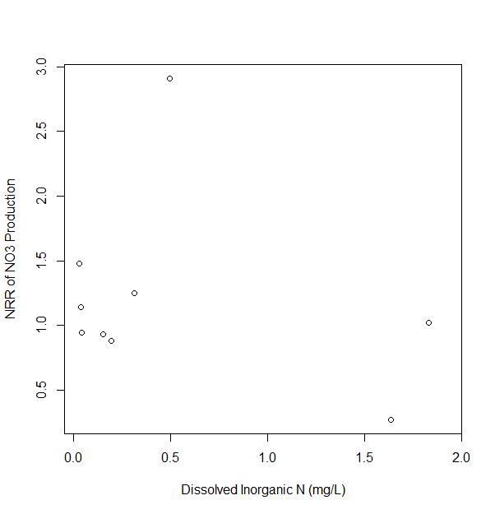
Nutrient Response to Water Chemistry
p=0.48
Production response was not related to background DIN

Slide 16
Nutrient Limitation Status of CR
Summer
→Fall
N
→ N
N
→ no lim
Nutrient limitation status changed in 1 site between summer and fall
Release of N limitation
Two sites could not be evaluated due to loss of control samples
N
→ N
no lim
→ no lim
P
→ ?
no lim
→ ?

Slide 17
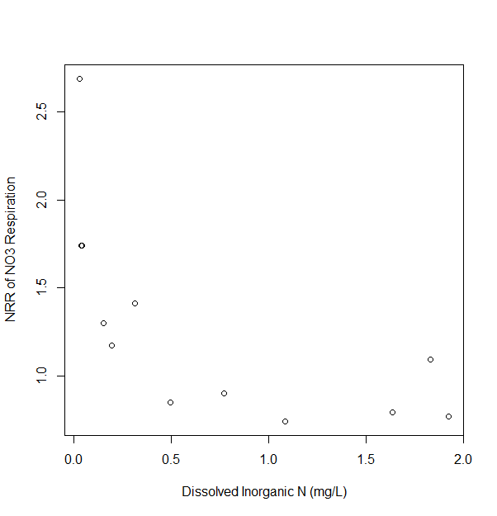
Nutrient Response to Water Chemistry
R²=0.37
p=0.021
Respiration response was inversely related to background DIN

Slide 18
Conclusions
End of irrigation increased mainstem NO₃⁻ similar to what was documented in a tributary
The NO₃⁻ increase relieved N limitation of GPP and CR in some sites but not others
Silica limitation was observed in downstream sites that often have high N and P concentrations

Slide 19
Implications
Less retention of NO₃⁻ pulsed in late fall/winter due to low light, thus increasing export
Terrestrial DOM is likely pulsed after the irrigation season too, with consequences for the DOM lability and the heterotrophic community
Silica limitation of GPP should be investigated in systems with high N and P concentrations

Slide 20
Acknowledgements
Yakama Nation for site access
Rhenton Brimberry, Cassandra Elkins, Alifya Saify, Noelle Scofield, Allison Staten, and Sarah’s parental units all assisted in the field and in the lab
Internal funding from CWU and WSU helped make this research possible

